Slide 1


Embedded programing course
IoT-TLU Laboratory

Slide 2
Get started with Raspberry pi
First Rules
Overview of Raspberry Pi
Start a Raspberry Pi
Lab #1: Controlling a LED – GPIO
Lab #2: Displaying on LCD 16x2 I2C

Slide 3
Rules
You might actually damage hardware!
Double check when you do wiring
Do not connect any unintended GPIO pins, or you will short circuit the Pi
During wiring, Power off the Pi
Do not touch with wet fingers
OS on SD is vulnerable. Use proper sequence to operate:
"sudo shutdown –h now"
"sudo reboot".
Think "why", and consult hardware reference for better understanding
Reading hardware references is a must-have skill
You don't have to read a reference thoroughly at the beginning (Later, you will)

Slide 4
Get started with Raspberry pi
First Rules
Overview of Raspberry Pi
Start a Raspberry Pi
Lab #1: Controlling a LED – GPIO
Lab #2: Displaying on LCD 16x2 I2C

Slide 5
Overview of Raspberry Pi
During the course, the Raspberry Pi 3 model B will be used:
Quad Core 1.2GHz Broadcom BCM2837 64bit CPU
1GB RAM
BCM43438 wireless LAN and Bluetooth Low Energy (BLE) on board
40-pin extended GPIO
4 USB 2 ports
4 Pole stereo output and composite video port
Full size HDMI
CSI camera port for connecting a Raspberry Pi camera
DSI display port for connecting a Raspberry Pi touchscreen display
Micro SD port for loading your operating system and storing data
Upgraded switched Micro USB power source up to 2.5A

Slide 6
Overview of Raspberry Pi
The Pi runs Linux – specially designed distribution called, Raspbian https://www.raspbian.org/
You download the OS image, and write on the SD on your development PC
You insert the SD into slot of the Pi, then boot up. That's all for booting Raspbian

Slide 7
Overview of Raspberry Pi
Our devices has been pre-configured:
Raspbian on SD card
Keyboard mapping for US layout
WiFi usage and IP address for 192.168.1.x/255.255.255.0 network segment, which differs on each device
Remote X server (xrdp) waiting for a connection from your development PC
The use of GPIO, I2C prepared
So you can power on the Pi, and connect to the Pi using Windows Remote Desktop

Slide 8
GPIO (GENERAL-PURPOSE INPUT/OUTPUT)
General-purpose I/O is a topic near to the hearts of the Pi, because this is the interface to the outside world.
The BCM2835 is flexibly designed to allow I/O pins to be reconfigured under software control. Ex: GPIO 14 can be an input, an output, or operate as a serial port TX data line.
One of the challenges related to the Pi’s GPIO interface is that it uses a weak CMOS 3V interface. The GPIO pins are susceptible to static electricity damage, and the I/O pins are weak drivers (2 to 16 mA). Additionally, GPIO power must be budgeted from the total spare current capacity of 50 mA

Slide 9
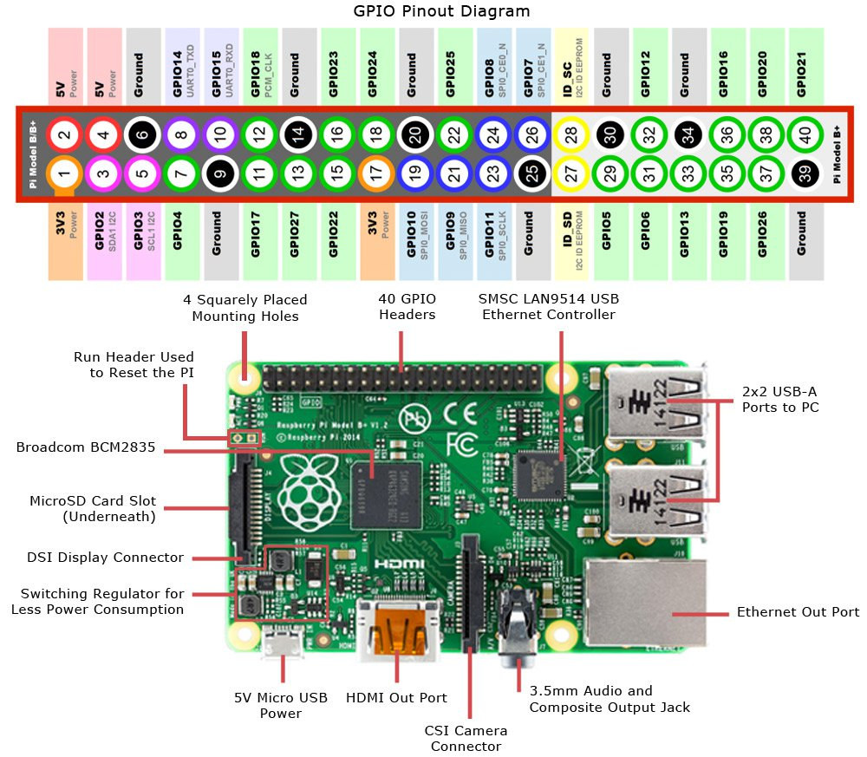
GPIO Pinout Diagram

Slide 10
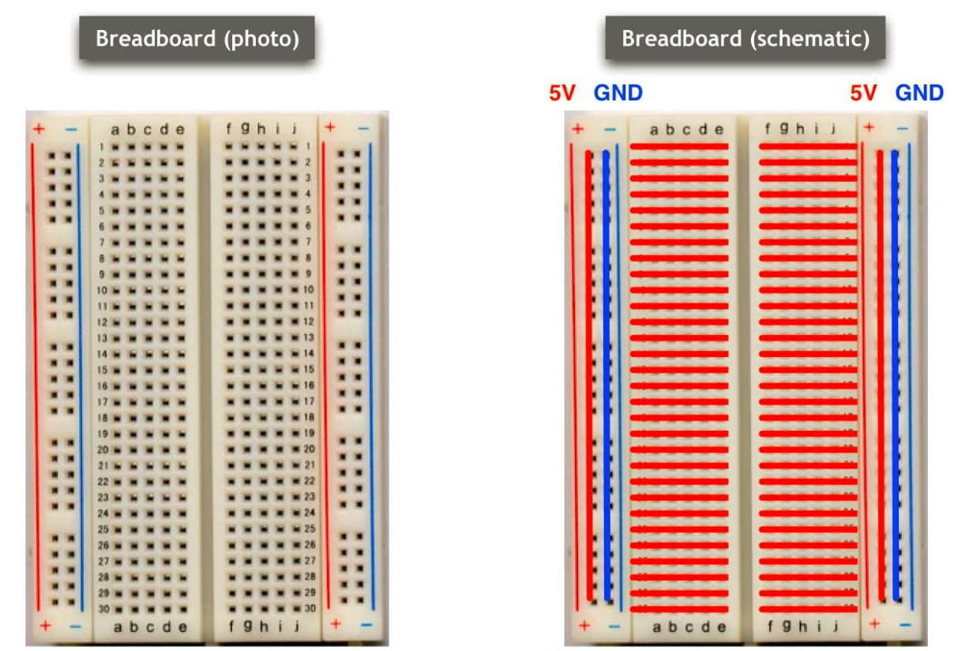
Breadboard

Slide 11
Power Supply
Unlike the normal software development, one of the often neglected, but important this is the power supply
Improper power supply make your program unstable – sudden reboot, system freeze, and unstable software
The minimum requirement for the Pi: 5V, 700mA but considering 5V, 1.2A as a minimum.
Also, depending on the peripheral connections, the more power will be required. If you use 4USB ports, provide 2.5 A
The Pi has on-board 5V regulator, which accept input from 4.75 to 5.25(V)

Slide 12
Get started with Raspberry pi
First Rules
Overview of Raspberry Pi
Start a Raspberry Pi
Lab #1: Controlling a LED – GPIO
Lab #2: Displaying on LCD 16x2 I2C

Slide 13
Start a Raspberry Pi
Your Pi has been configured
WiFi IP address labeled on clear case
Wired add 100 to your WiFi address. i.e) 192.168.1.101 => 192.168.1.201
Keyboard English
If you have a problem with networking, remove WiFi USB dongle, and connect LAN cable
Then, access to the given IP address for wired network using Remote Desktop or SSH
You cannot connect WiFi/Wired at the same time (due to the routing configuration)

Slide 14
Get started with Raspberry pi
First Rules
Overview of Raspberry Pi
Start a Raspberry Pi
Lab #1: Controlling a LED – GPIO
Lab #2: Displaying on LCD 16x2 I2C

Slide 15
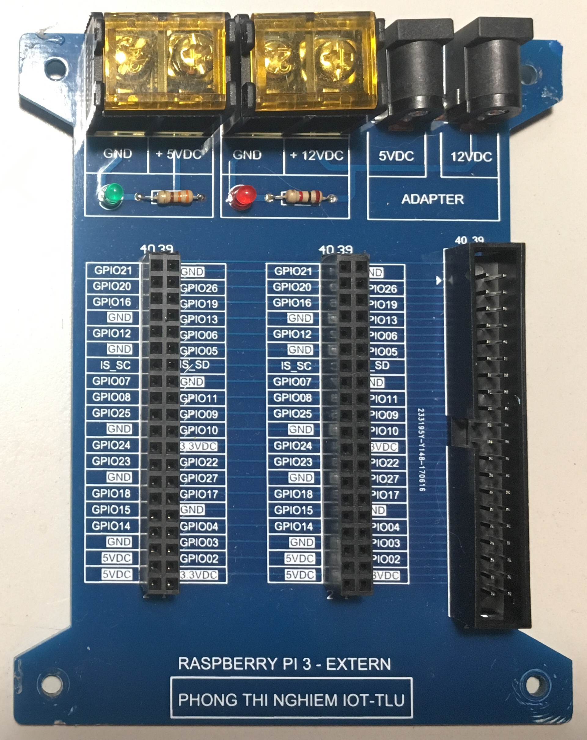
Raspberry pi 3 - Extension

Slide 16
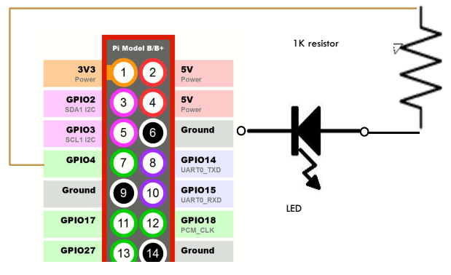
Controlling a LED - Circuit
Now you know how to create the circuit for LED
We control LED via software, so it blinks
In order to control the current to LED, you use GPIO of pin headers

Slide 17
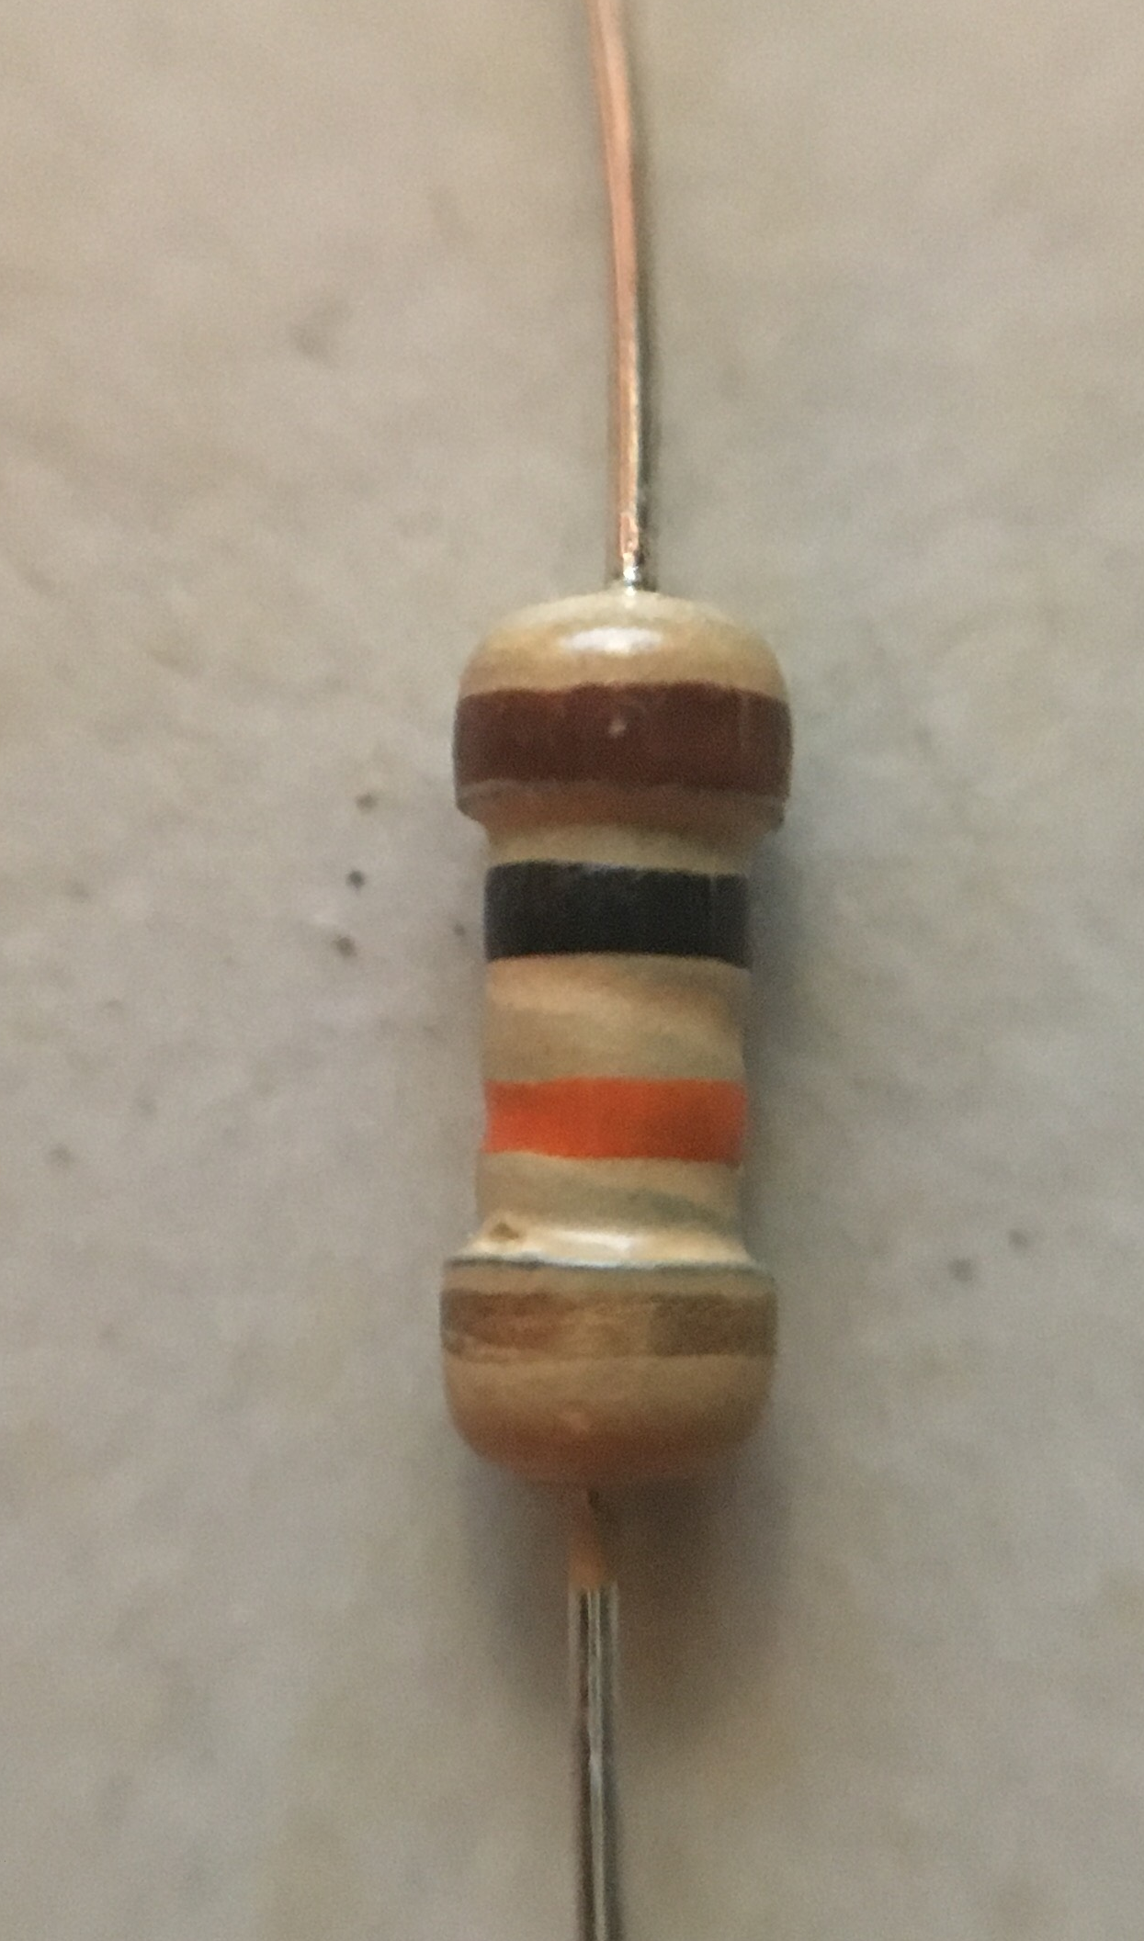
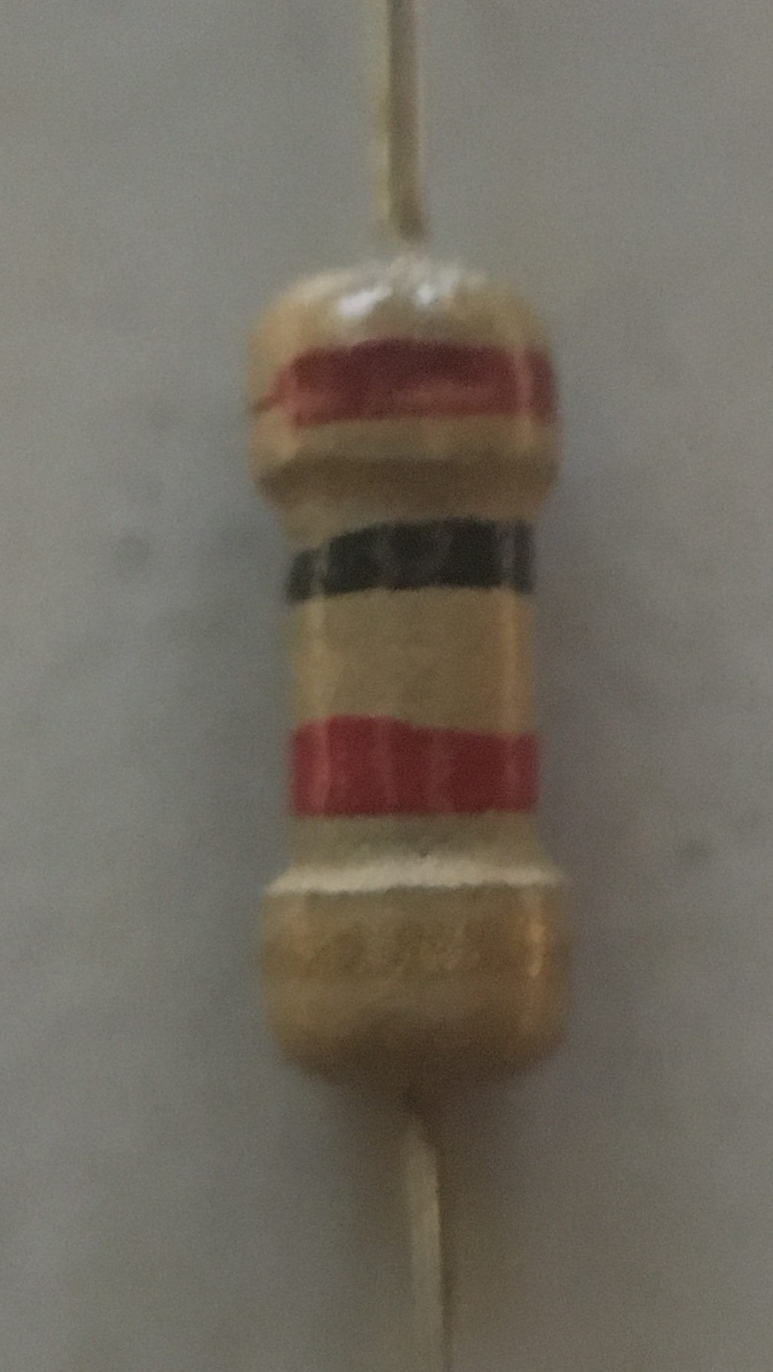
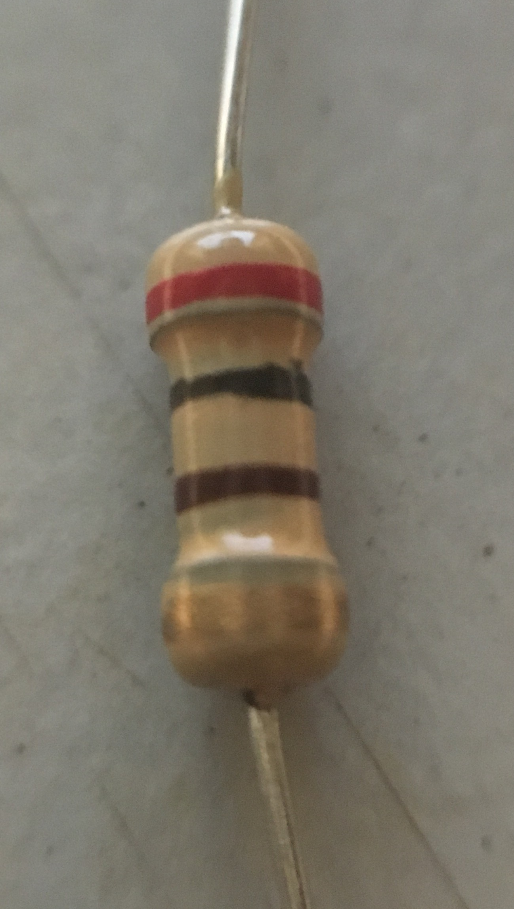
Controlling a LED - Circuit
How to read value of a resistor
10K
1K
200

Slide 18
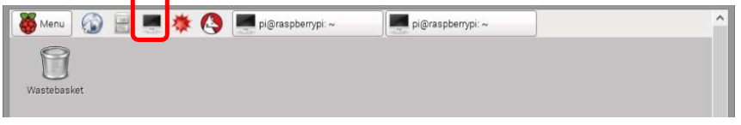
Controlling a LED - Software
Connect to the Pi via Remote Desktop, and login
Open LXTerminal by clicking the icon of upper taskbar
Open the "IDLE" with root privilege by:
From menu of IDLE, select "File > New", or press CTRL+N, to open a new window

Slide 19
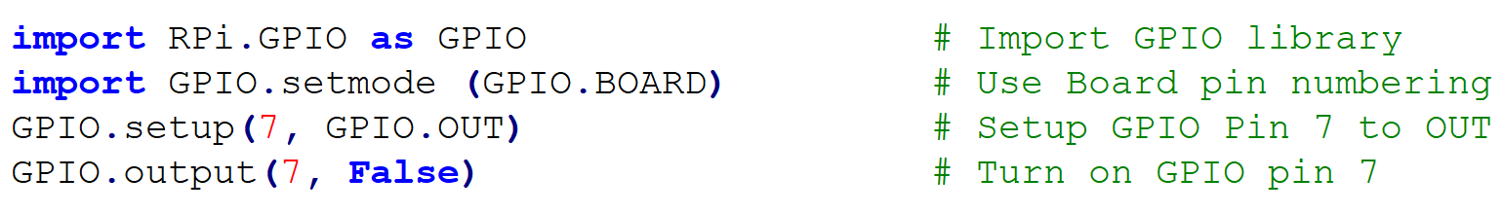
Controlling a LED - Software
Place your code in the editor
From IDLE menu, "File > Save", or CTRL+s, to save. Name "turnON_led.py"
Make sure your LED is still on
"Run > Run Module", or F5, and observe the LED state

Slide 20
Controlling a LED – Blinking LED
Let's make the LED blinking, by changing the GPIO pin7 state
Open the new file in IDLE
Type as the following source code in the next slide
Save as "blink_led.py", and run by hitting F5
Observe the source code, to get used to Python and GPIO operation

Slide 21
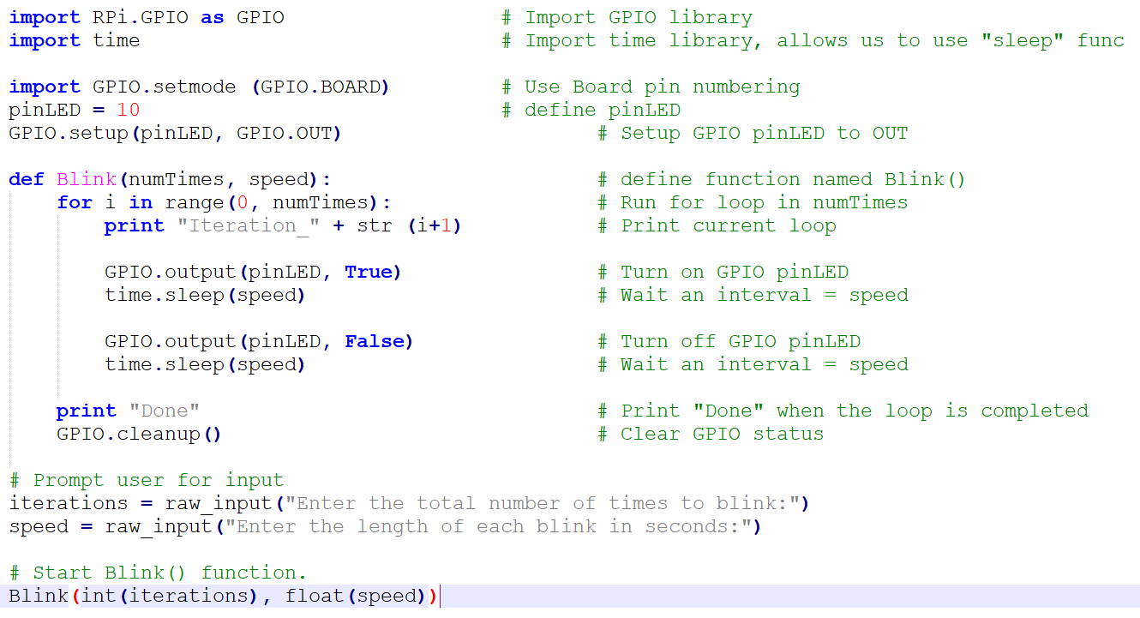
Controlling a LED – Blinking LED – Source code

Slide 22
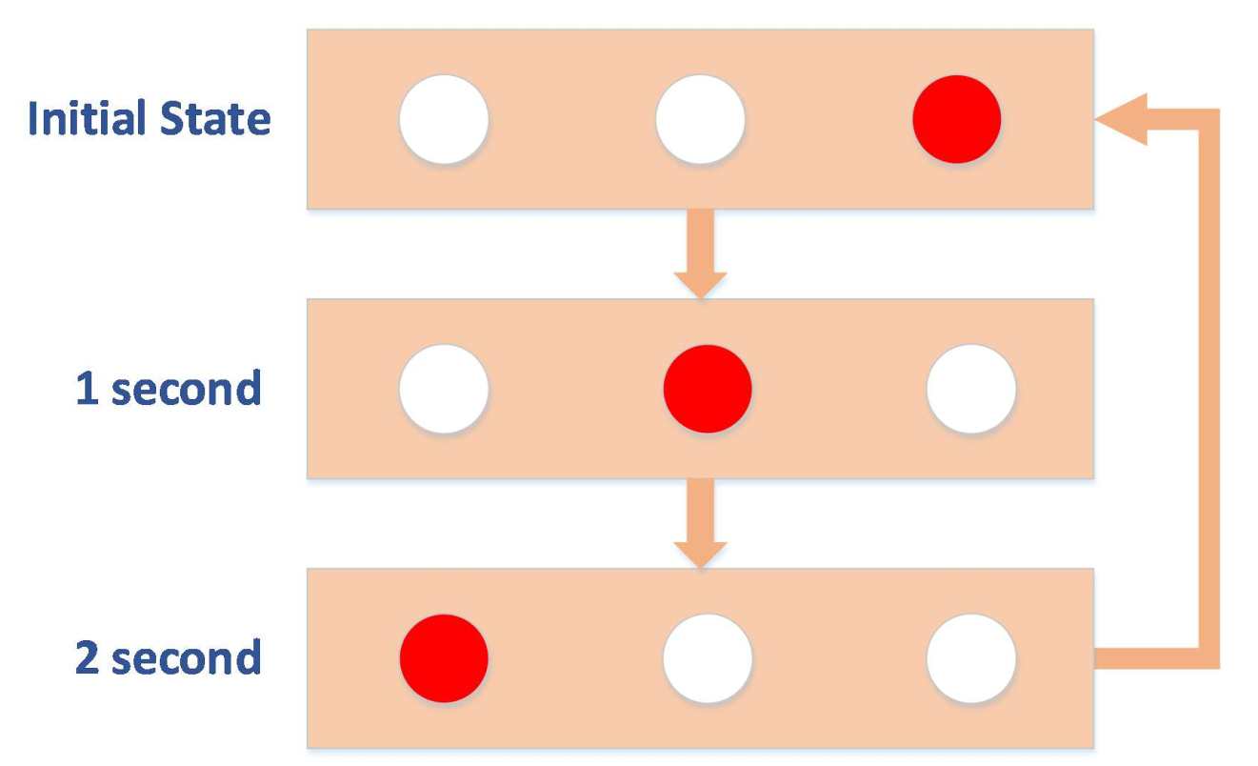
Assignment – “The Knight Rider”
Put 3 LEDs, light them one by one at 0.05 second (50ms) interval. When the last LED turns off, turn on the first LED, and start the iteration again.

Slide 23
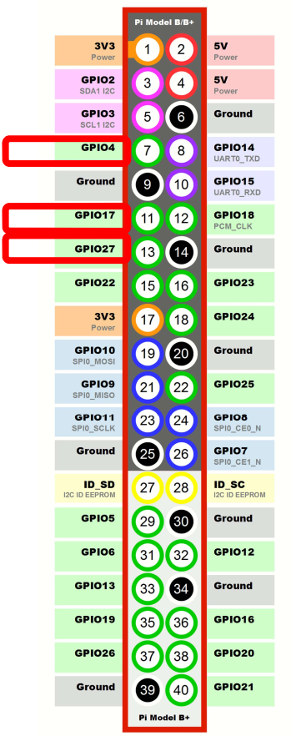
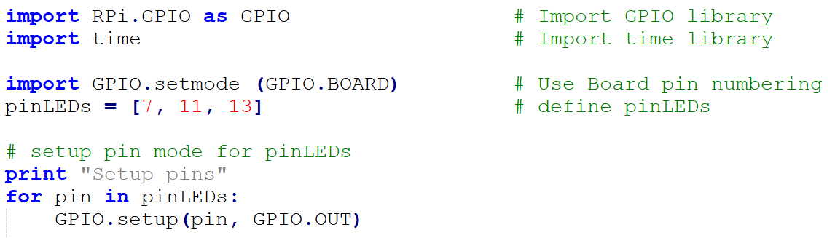
“The Knight Rider” – How to do it?
Use Pin 7 (GPIO04), 11 (GPIO17), 13 (GPIO27)
You can put them in a list
Set to the output mode by looping the pin list

Slide 24
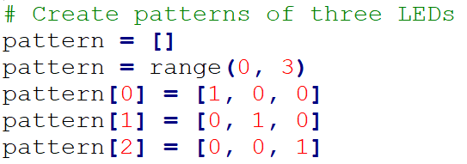
“The Knight Rider” – How to do it?
Create each pattern, 3 in total, by using a list

Slide 25
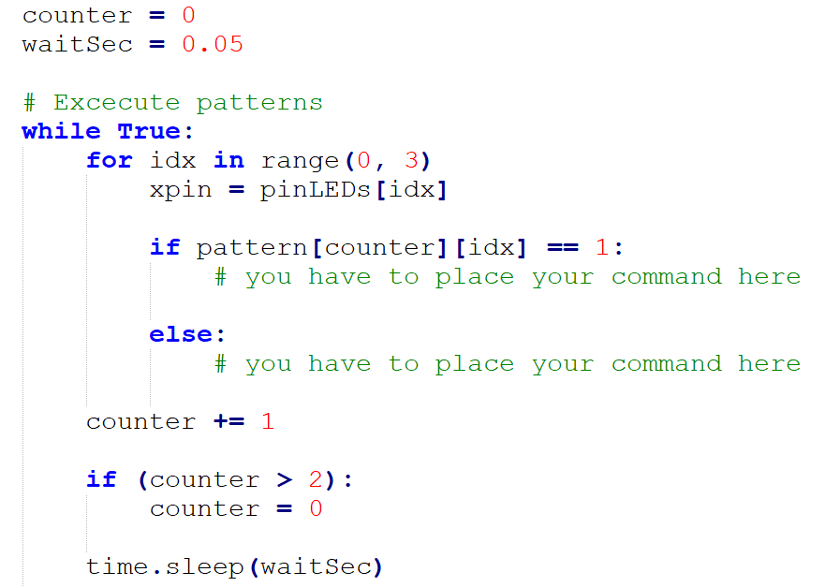
“The Knight Rider” – How to do it?
Now execute the pattern

Slide 26
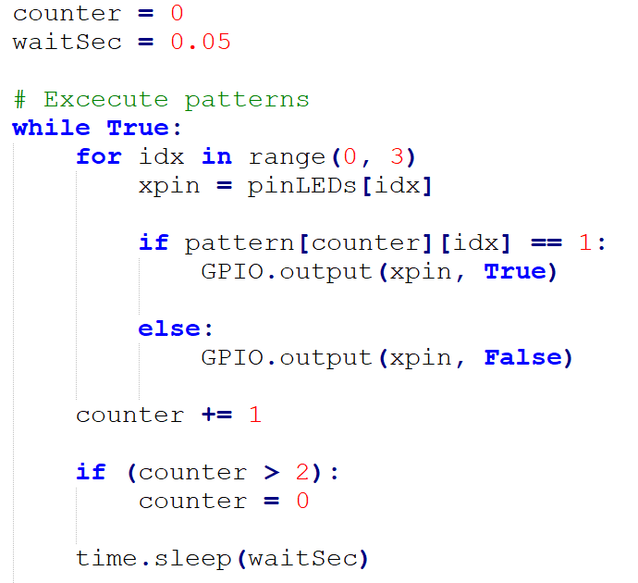
“The Knight Rider” – How to do it?
Now execute the pattern

Slide 27
“The Knight Rider” – Assignment 2
Now you have better understanding of Python, the circuit, and control theory, add two more LEDs on the circuit, and implement 5 LEDs Knight Rider and let’s user choose the direction of Knight Rider.

Slide 28
Get started with Raspberry pi
First Rules
Overview of Raspberry Pi
Start a Raspberry Pi
Lab #1: Controlling a LED – GPIO
Lab #2: Displaying on LCD 16x2 I2C

Slide 29
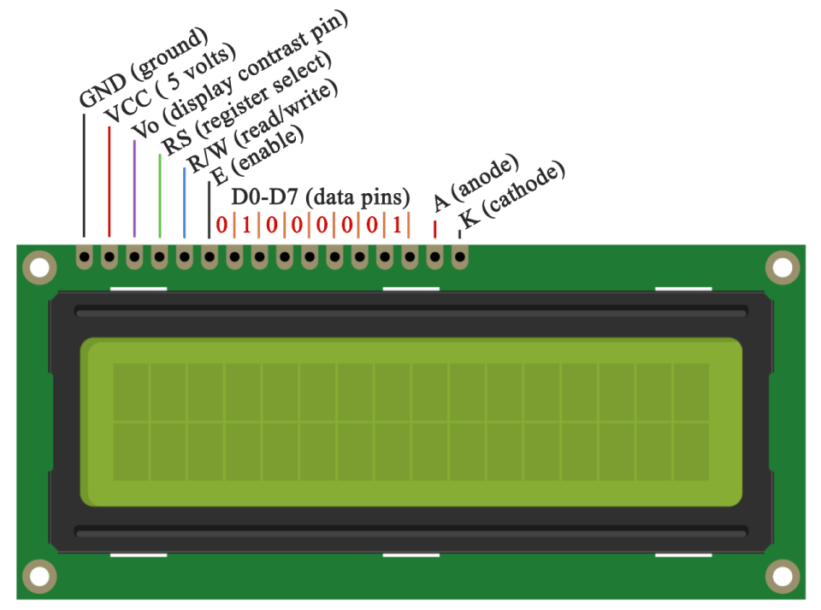
LCD 16x2

Slide 30
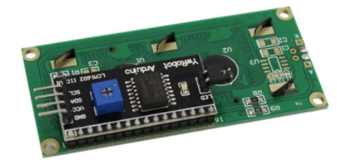
Connect the LCD
I2C (inter-integrated circuit) is also known as the two-wire interface since it only uses two wires to send and receive data. Actually it takes four if you count the Vcc and ground wires, but the power could always come from another source.
Connecting an LCD with an I2C backpack is pretty self-explanatory. Connect the SDA pin on the Pi to the SDA pin on the LCD, and the SCL pin on the Pi to the SCL pin on the LCD. The ground and Vcc pins will also need to be connected. Most LCDs can operate with 3.3V, but they’re meant to be run on 5V, so connect it to the 5V pin of the Pi if possible.

Slide 31
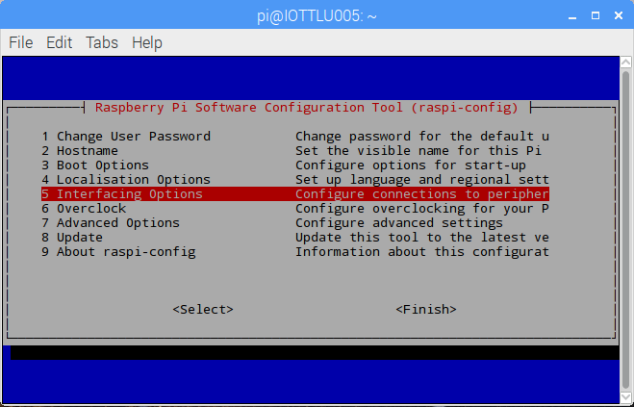
Enable I2C on the PI
Enable I2C in Raspi-config
First, log in to your Pi and enter sudo raspi-config to access the configuration menu. Then arrow down and select “Advanced Settings”:

Slide 32
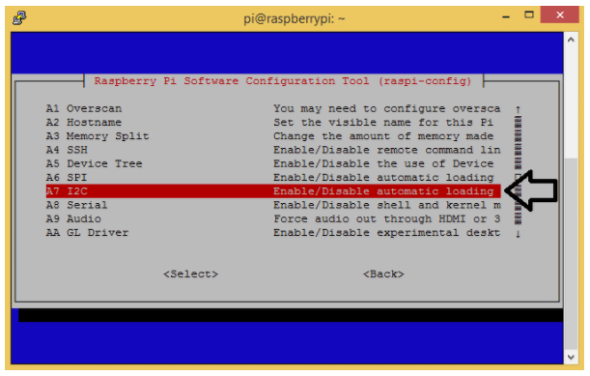
Enable I2C on the PI
Enable I2C in Raspi-config
Now arrow down and select “I2C Enable/Disable automatic loading”
Choose “Yes” at the next prompt, exit the configuration menu, and reboot the Pi to activate the settings.

Slide 33
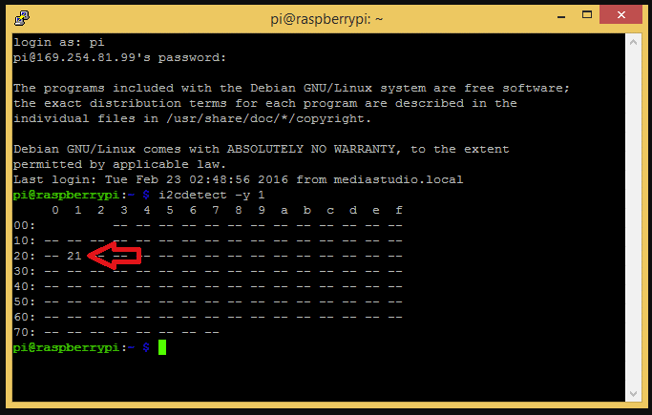
Enable I2C on the PI
Install I2C-tools and smbus
Run command “sudo apt-get install i2c-tools” to install I2C-tools
Run command “sudo apt-get install python-smbus” to install smbus
Rebot Pi and login again
Run command “i2cdetect -y 1” to detect I2C device

Slide 34
Displaying LCD
Install LCD library
Run command “git clone https://anhtien17@bitbucket.org/anhtien17/lcd-master.git”
Go to directory “lcd-master”
Run command “sudo sh install.sh”
Wait for Raspberry Pi re-booting
Run demo_lcd.py

